Slide 1

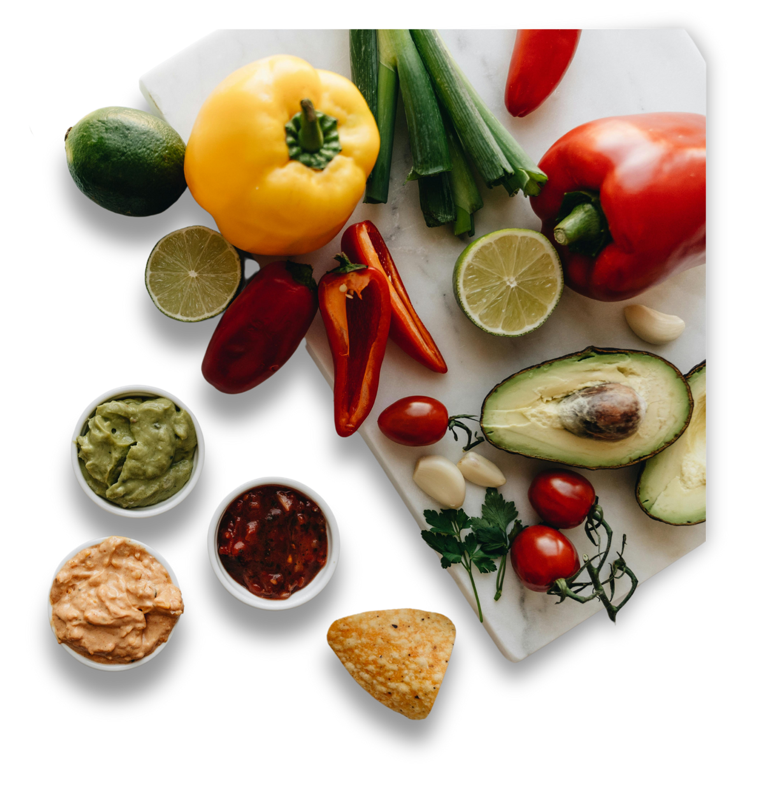

AI BASED DIET RECOMMENDATION SYSTEM-NUTRIFIT
Generates Comprehensive Diet Plan according to User preferences

Slide 2


LOGO
Home
About
Service
Contact
Presented By
2022- CS-112
2022- CS-151
Saba Shahdin
Afeera Fatima

Slide 3

Contact
Approach
01.
02.
03.
BMI Class
Recommendation
Food Allergies
Predicts BMI Class of User suing KNN
Used Content Based Filtering to recommend according to user preference
Remove Dishes with Allergic Food Ingredients

Slide 4

USER Preferences
Age
Weight
Height
Gender
Physical Activity
Food allergies

Slide 5



LOGO
Home
About
Service
Contact
Processing
Predict BMI Class
Calculate Total Calories and Break them into Macro Nutrients

Slide 6




OUTPUT
Recommend Foods which aligns with user body Needs (Calories , Fats , proteins)
Recommend Foods using Content Based Filtering and filtering by removing Food Items with Allergic Ingredients

Slide 7

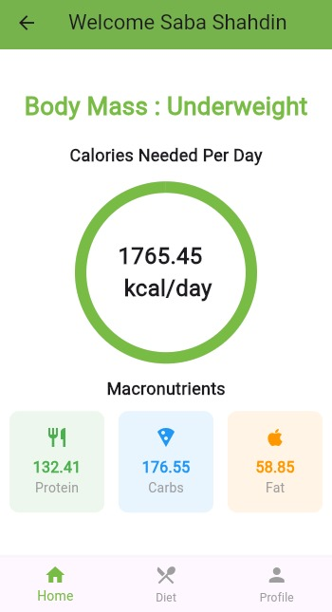
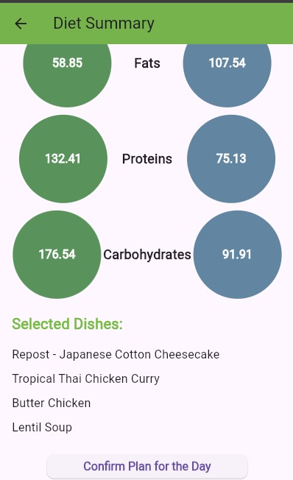
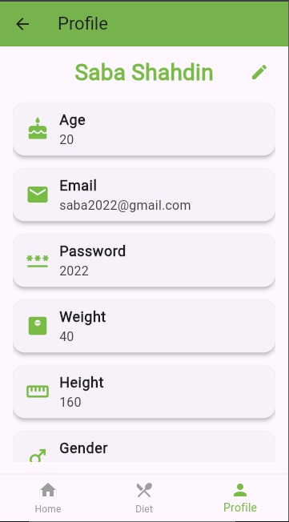
LOGO
Home
About
Service
Contact
Image

Slide 8
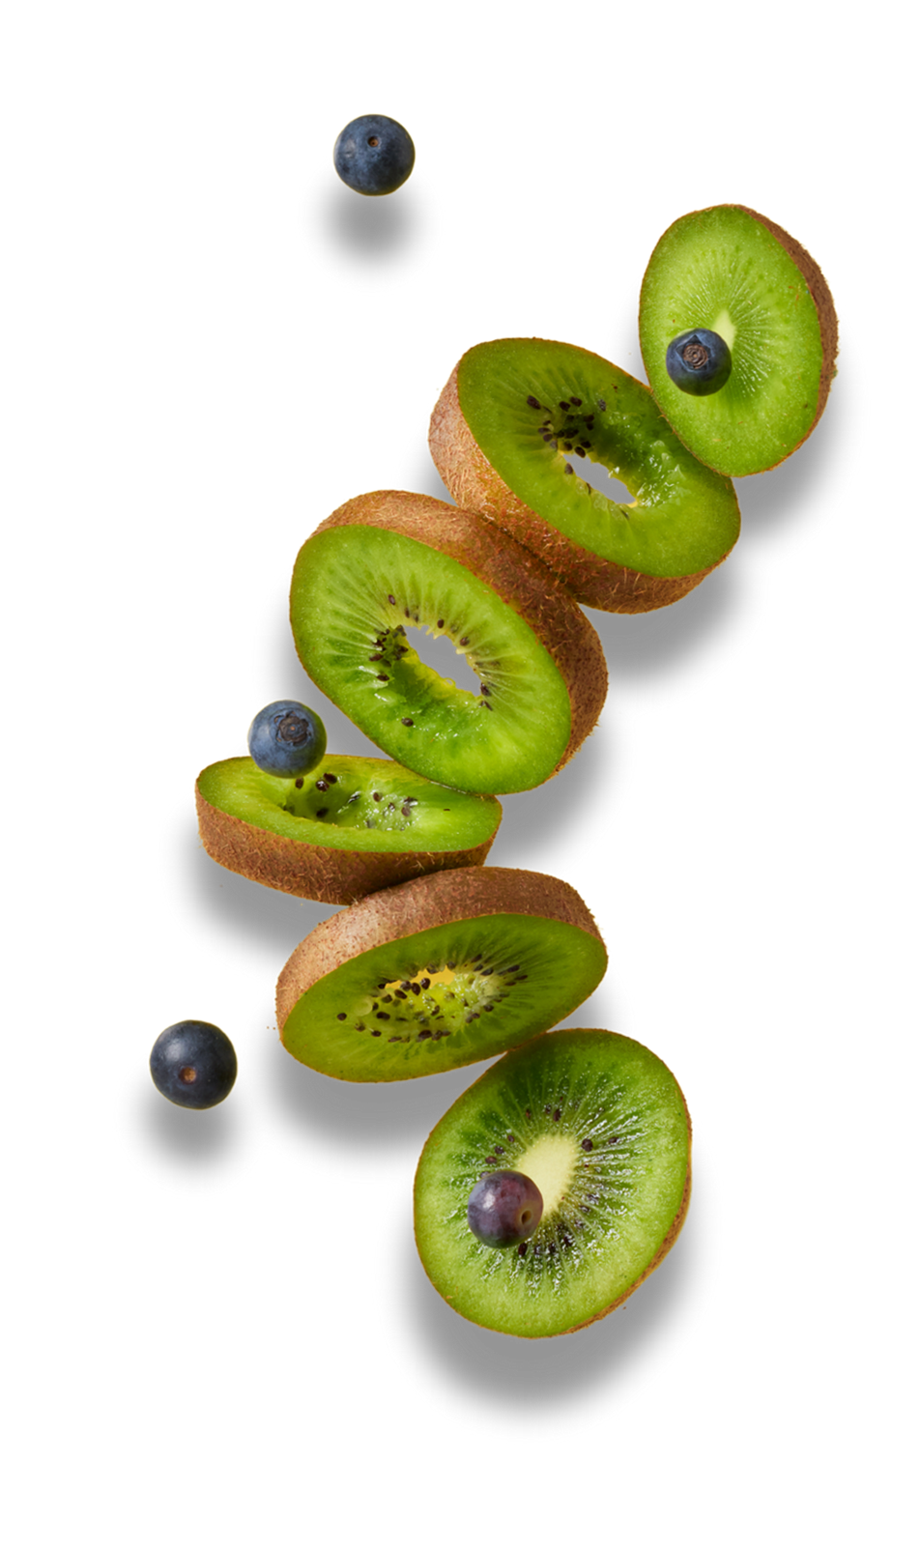
THANK YOU

